Slide 1


Slide 2

#LifeKoKaroLift
SGC Coaching:
Articulate your Journey | Activate Your Vigour| Accelerate Mutual Growth
Session 19
Transfer Learning

Slide 3
Agenda
Quick Recap – (15 min)
Focused Teaching (60 min)
Doubts Resolutions (15 min)
Transfer Learning
doubts resolutions
Last 2 weeks

Slide 4
Recap: What the learner have learnt in the week
Quick Glance at Key Learnings
Neural Network
Forward Propagation
Backward Propagation
Basics
When to use
What is
When to use
What is
Basic Understanding

Slide 5
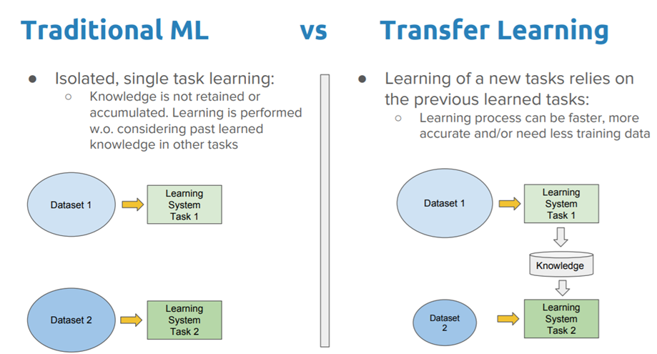
Transfer Learning
Transfer learning is the idea of overcoming the isolated learning paradigm and utilizing knowledge acquired for one task to solve related ones

Slide 6
Transfer Learning Types
Types
Inductive
Transductive
Unsupervised

Slide 7
Transfer Learning
Instance Transfer
Feature-representation transfer
Parameter transfer
Relational-knowledge transfer

Slide 8
Coding Time
Coding Time

Slide 9

Doubts Resolutions

